Slide 1
COMP 3100
Week 7 - Monday

Slide 2
Last time
What did we talk about last time?
Graphic design
Software engineering design
Architectural styles

Slide 3
Questions?

Slide 4
Quick Notes on Project Scheduling

Slide 5
Project scheduling
Project scheduling is organizing the work
  Into separate tasks
  When the tasks will be done
  Who will do them
Both waterfall and agile approaches benefit from scheduling
  For waterfall, all tasks in the project are scheduled
  For agile, there might be an overall schedule for when major phases of the project will be completed
Tasks should last at least a week but not more than two months
  A task taking more than two months should be broken into subtasks
It's helpful to have visualizations of these tasks

Slide 6
Example of tasks
This table shows all the task information, but it's hard to visualize
M is used to label milestones
Task | Effort (person-days) | Duration (days) | Dependencies
T1 | 15 | 10
T2 | 8 | 15
T3 | 20 | 15 | T1 (M1)
T4 | 5 | 10
T5 | 5 | 10 | T2, T4 (M3)
T6 | 10 | 5 | T1, T2 (M4)
T7 | 25 | 20 | T1 (M1)
T8 | 75 | 25 | T4 (M2)
T9 | 10 | 15 | T3, T6 (M5)
T10 | 20 | 15 | T7, T8 (M6)
T11 | 10 | 10 | T9 (M7)
T12 | 20 | 10 | T10, T11 (M8)

Slide 7
Gantt charts
Gantt charts show the same information, but in a much clearer way
  Bars shows the length of each task
  Dependencies are shown by the starting point of each task
Recall that you have to make a Gantt chart for Project 2
Thus, you need to break down your product into tasks and figure out which tasks are dependent on which

Slide 8
Staff allocation
It's also possible to visualize which staff members are working on which task (and when)
Doing so might be helpful but is not required for Project 2

Slide 9
Detailed Design

Slide 10
Detailed design
Detailed design is specifying the internals of the major components
Sequence diagrams and state diagrams can be useful for this kind of design
However, class diagrams are indispensable

Slide 11
More depth on class diagrams
Class diagrams are made up of class symbols (rectangles)
These class symbols contain one or more compartments
The top compartment has the class name
A second, optional compartment often contains attributes (called member variables in Java classes)
  Often followed by a colon with the type
A third, optional compartment often contains operations (called methods in Java classes)
  Sometimes followed by parameter and return types
Visibility modifiers can be marked:
  + for public
  # for protected
  ~ for package
  - for private
Only important attributes and operations need to be specified
  Classes might contain others that aren't shown

Slide 12
Inheritance and interfaces in class diagrams
Inheritance is shown with the generalization connector
  A solid line from the child class to a solid triangle connected to the parent class
  Confusingly, this means that children classes point at their parent classes
Interfaces look like classes but are marked with «interface» above the class name
  This kind of marking is called a stereotype
  Stereotypes show extra information that wasn't part of the original UML class diagram specification
Classes that implement interfaces have dashed lines leading to a solid triangle connected to the interface

Slide 13
Other associations
Associations are shown with lines between classes
  Associations can be labeled to explain them
  The lines can be marked with the multiplicity, showing how many of each class can be associated with the other
  The multiplicity can be comma separated lists or ranges, and * means zero or more
When a class is part of another class, the part is connected by a line and a diamond (the aggregation connection) to the whole

Slide 14
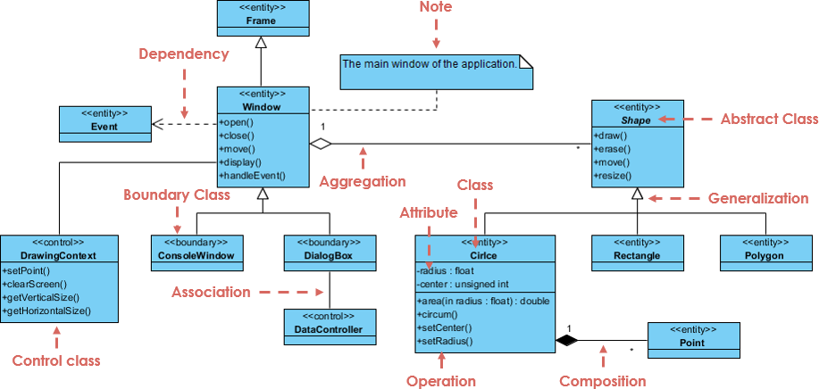
Complex example
From visual-paradigm.com

Slide 15
Design Patterns

Slide 16
Object class identification
With an architecture designed, you can break down its components into the actual software objects you will need
  There's no cookbook way to do this
  It requires thinking long and hard about how best to break functionality into small pieces
Possible approaches:
  Look at the written description of your system. Nouns map to objects and members. Verbs map to operations, services, and methods.
  Tangible entities map to objects and members. For example, aircraft, managers, events, and locations might all be objects.
  Analyze different use cases and try to find objects that use cases have in common.

Slide 17
Design patterns
Software design patterns are ways of designing objects that have been used successfully in the past
  Think of them as rough blueprints or guidelines
The idea emerged in the late 70s and is best known from the 1994 book Design Patterns: Elements of Reusable Object-Oriented Software
  23 different patterns, written by the Gang of Four: Gamma, Helm, Johnson, and Vlissides
10 years ago, job interviews routinely asked questions about design patterns
The software engineering community is not as focused on design patterns now, though they are still useful

Slide 18
Elements of design patterns
Design patterns have four essential elements:
  A meaningful name
  A description of the problem area that explains when the pattern may be applied
  A solution description of the parts of the design, their relationships, and their responsibilities
  A statement of the consequences of using the design pattern
Patterns are more abstract than code

Slide 19
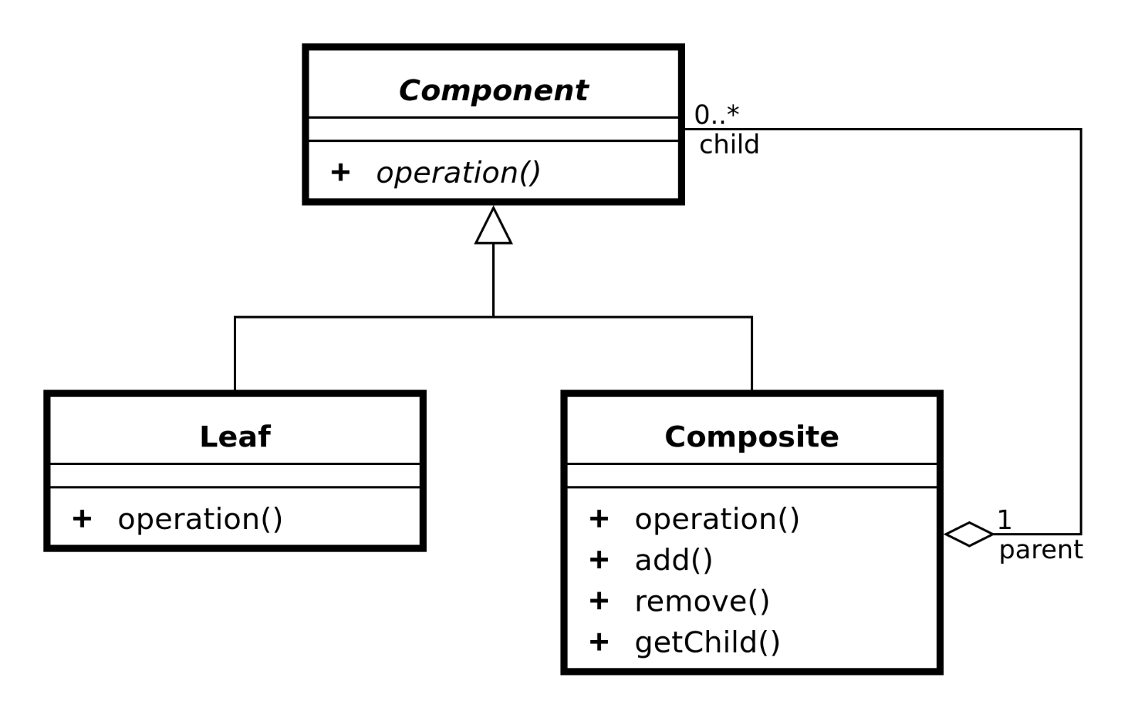
Composite pattern
The composite pattern is useful for part-whole hierarchies of objects
A group of objects somewhere in the hierarchy can be treated like a single object
The Swing library uses the composite pattern for its graphical components
Problems the composite pattern solves:
  Representing a part-whole hierarchy so that clients can treat parts and wholes the same
  Representing a part-whole hierarchy as a tree

Slide 20
Composite pattern in code
interface Component {
public void doAction(); // Draw, print, etc.
}
public class Composite implements Component {
private List<Component> children = new ArrayList<>();
  public void add(Component component) {
  children.add(component);
  }
  public void doAction() {
  for (Component component : children)
  component.doAction();
  }
}

Slide 21
Command pattern
The command pattern is useful for encapsulating an action in an object
The action is independent from the objects that used it and can be stored for later
The Swing library uses the command pattern for events
Problems the command pattern solves:
  Decoupling the requester from a request

Slide 22
Command pattern in code
interface Command {
public void execute(); // Do something
}
public class Invoker {
private Map<String, Command> commands = new HashMap<>();
  public void register(String name, Command command) {
  commands.put(name, command);
  }
  public void execute(String name) {
  Command command = commands.get(name);
  if (command == null)
  throw new IllegalStateException("No command!");
  command.execute();
  }
}

Slide 23
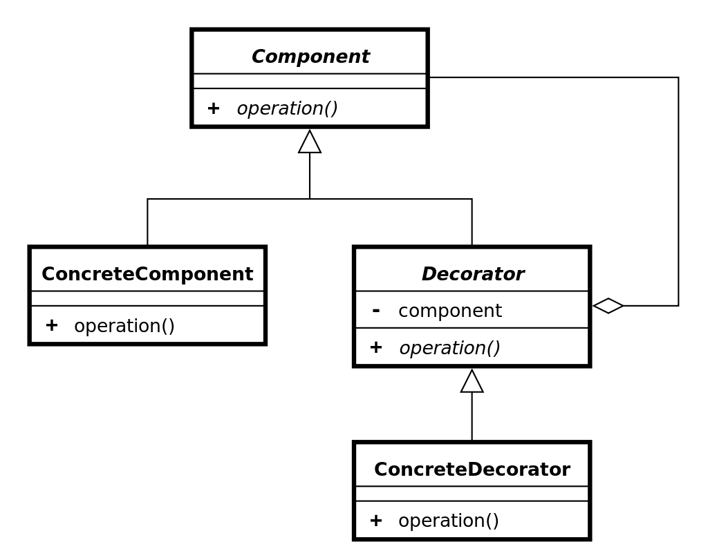
Decorator pattern
The decorator pattern provides a way to add responsibilities to an object dynamically at run-time
It is commonly used to customize the appearance of GUI elements
The Swing library uses the decorator pattern to customize borders
Problems the decorator pattern solves:
  Adding responsibilities to an object dynamically at run-time
  Providing a flexible alternative to inheritance for extending functionality

Slide 24
Decorator pattern in code
public class VerticalScrollBarDecorator extends WindowDecorator {
public VerticalScrollBarDecorator (Window windowToBeDecorated) {
super(windowToBeDecorated);
}
public void draw() {
super.draw();
drawVerticalScrollBar();
}
private void drawVerticalScrollBar() {
// Draw the vertical scrollbar
}
}

Slide 25
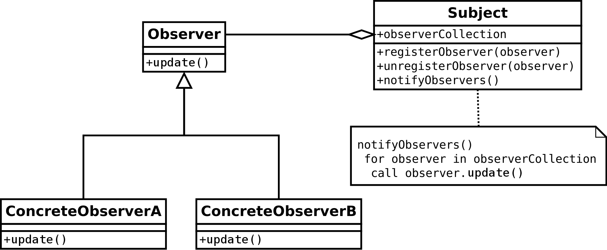
Observer pattern
The observer pattern is useful for a one-to-many dependency where one object changing can update many other objects
An observer pattern defines Subject and Observer objects
When a subject changes state, registered observers are updated automatically
Problems the observer pattern solves:
  Making a one-to-many dependency between objects without tightly coupling the objects
  Updating an arbitrarily large number of other objects automatically when one object changes state

Slide 26
Observer pattern in code
public class Subject {
private Object data;
private List<Observer> observers = new ArrayList<>();
  public void registerObserver(Observer observer) {
  observers.add(observer);
  }
  public void setData(Object data) {
  this.data = data;
  for (Observer observer : observers)
  observer.update(data);
  }
}

Slide 27
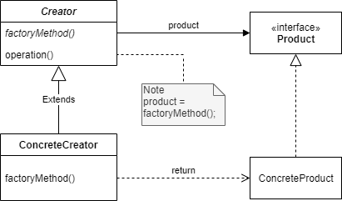
Factory method pattern
The factory method design pattern allows a method to be overridden so that a child class can determine what kind of object to create
A factory method is defined that is used to create objects
Problems the factory method pattern solves:
  Allowing subclasses to define which class to instantiate

Slide 28
Factory method pattern in code
interface Room {
public void connect(Room room);
}
public abstract class MazeGame {
private final List<Room> rooms = new ArrayList<>();
public MazeGame() {
Room room1 = makeRoom();
Room room2 = makeRoom();
room1.connect(room2);
rooms.add(room1);
rooms.add(room2);
}
abstract protected Room makeRoom();
}

Slide 29
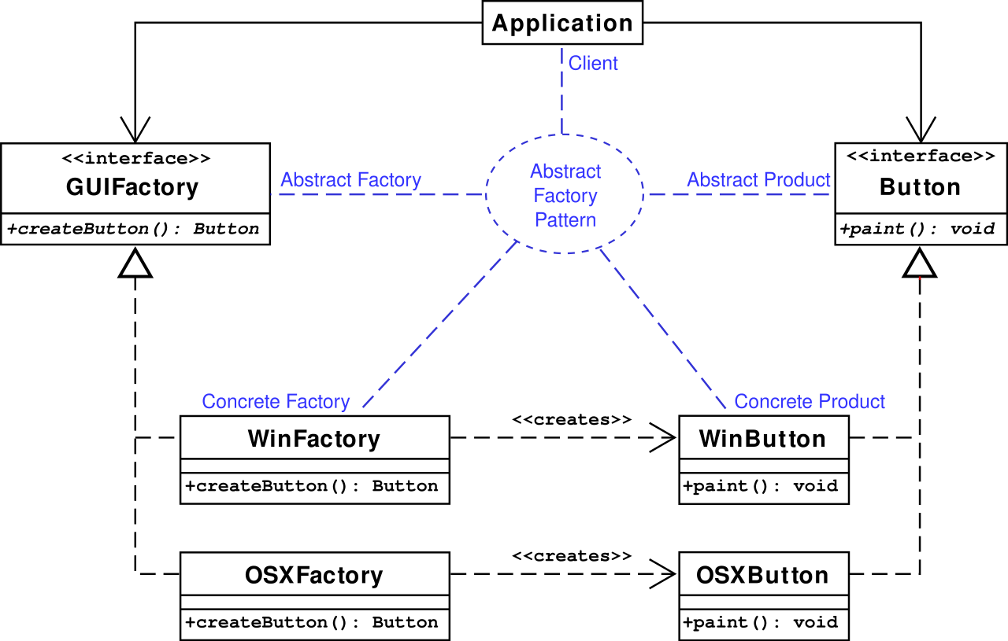
Abstract factory pattern
The abstract factory pattern is similar except that it uses some object as a factory instead of overriding a method
Problems the abstract factory pattern solves:
  Making a class be independent of the objects it requires
  Making a family of related objects

Slide 30
Abstract factory pattern
public interface Button {
void paint();
}
public interface GUIFactory {
public Button createButton();
}
public class WindowsFactory implements GUIFactory {
public Button createButton() {
return new WindowsButton();
}
}
public class OSXFactory implements GUIFactory {
public Button createButton() {
return new OSXButton();
}
}

Slide 31
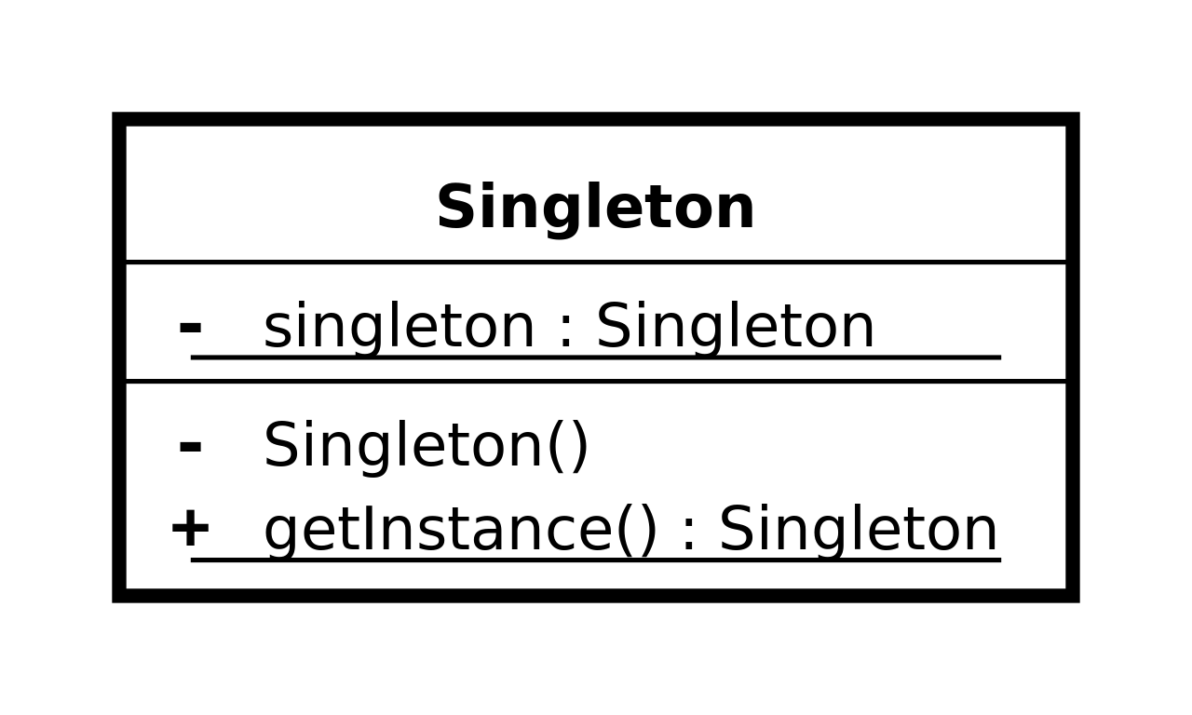
Singleton pattern
Sometimes it's useful to have only a single instance of a class
The singleton pattern makes it so that it's possible to make only one object of a class and makes it easy to access
Problems the singleton pattern solves:
  Ensuring that there's only one instance of a class
  Making the instance of a class easy to get

Slide 32
Singleton pattern in code
public final class Singleton {
private static final Singleton INSTANCE = new Singleton();
private Singleton() {}
public static Singleton getInstance() {
return INSTANCE;
}
}

Slide 33
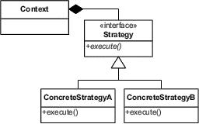
Strategy pattern
The strategy pattern allows an algorithm to be selected at run-time
In Java, that algorithm is usually encapsulated in the method of an object
Problems the strategy pattern solves:
  Configuring a class with an algorithm at run-time
  Selecting or exchanging an algorithm at run-time

Slide 34
Strategy pattern in code
interface BillingStrategy {
double getPrice(double rawPrice);
}
// Normal billing strategy (unchanged price)
public class NormalStrategy implements BillingStrategy {
public double getPrice(double rawPrice) {
return rawPrice;
}
}
// Strategy for Happy hour (50% discount)
public class HappyHourStrategy implements BillingStrategy {
public double getPrice(double rawPrice) {
return rawPrice*0.5;
}
}

Slide 35
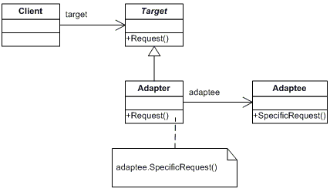
Adapter pattern
Sometimes you have an object that doesn't generate the right kind of output
The adapter pattern allows you to turn the output from something that gives one kind of output into the kind you need
Problems the adapter pattern solves:
  Reusing a class that doesn't have an interface the client requires
  Allowing classes with incompatible interfaces to work together

Slide 36
Adapter pattern
public interface IceProvider {
Ice getIce();
}
public class WaterToIce implements IceProvider {
private WaterMaker maker = null;
public WaterToIce(WaterMaker maker) {
this.maker = maker;
}
public Ice getIce() {
return maker.getWater().freeze();
}
}

Slide 37
Upcoming

Slide 38
Next time…
Construction techniques

Slide 39
Reminders
Read Chapter 8: Construction Techniques
Keep working on the draft of Project 2
  Due Friday!

